Slide 1
Chapter 5: Scheduling Chapter 6: Process Synchronization
Apr, 2020

Slide 2
Process Scheduling
Other Issues

Slide 3
Multiple-Processor Scheduling

Slide 4
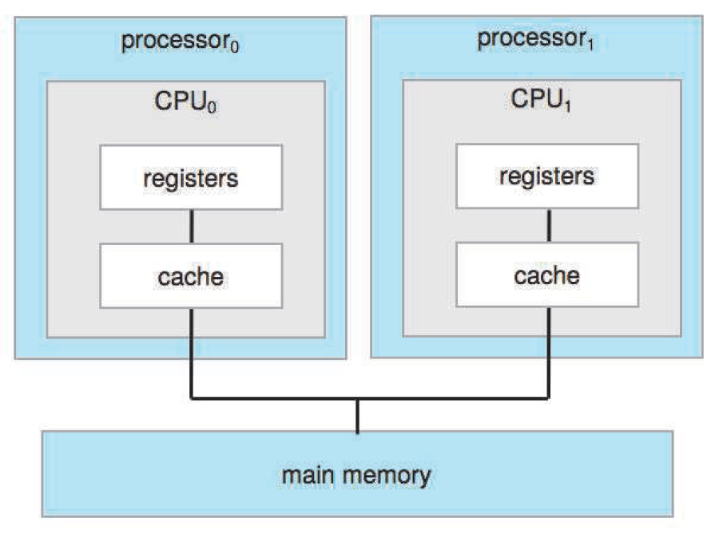
Multiple CPUs

Slide 5
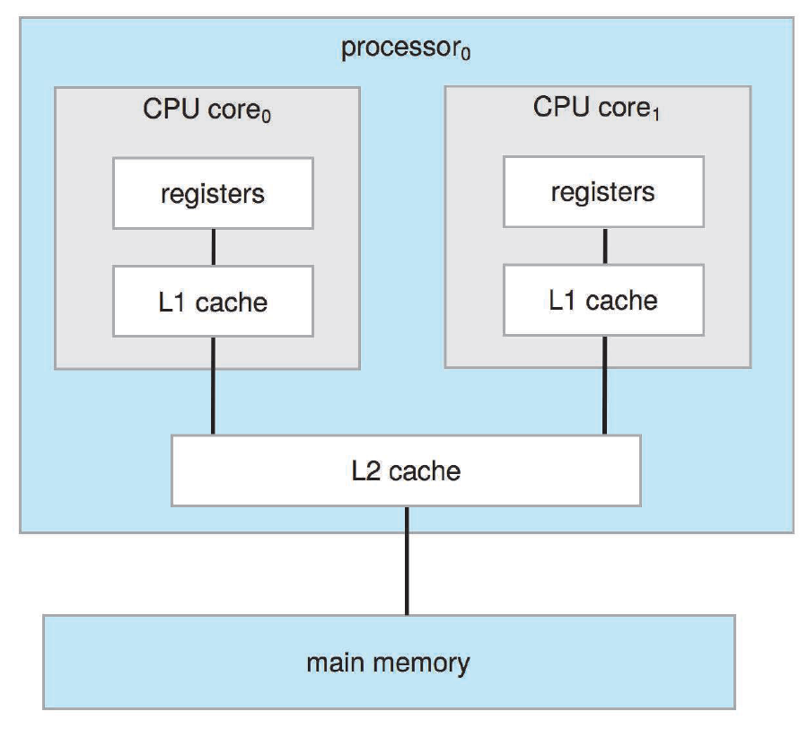
Multiple Cores

Slide 6

Hyper Threading

Slide 7

Hyper Threading

Slide 8
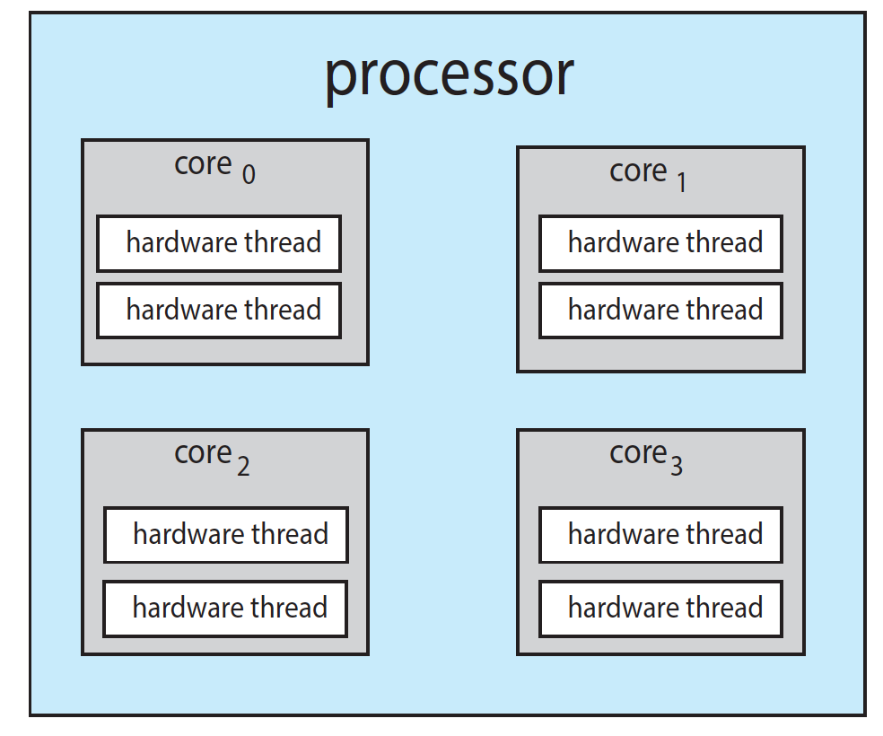
Hardware Threads

Slide 9
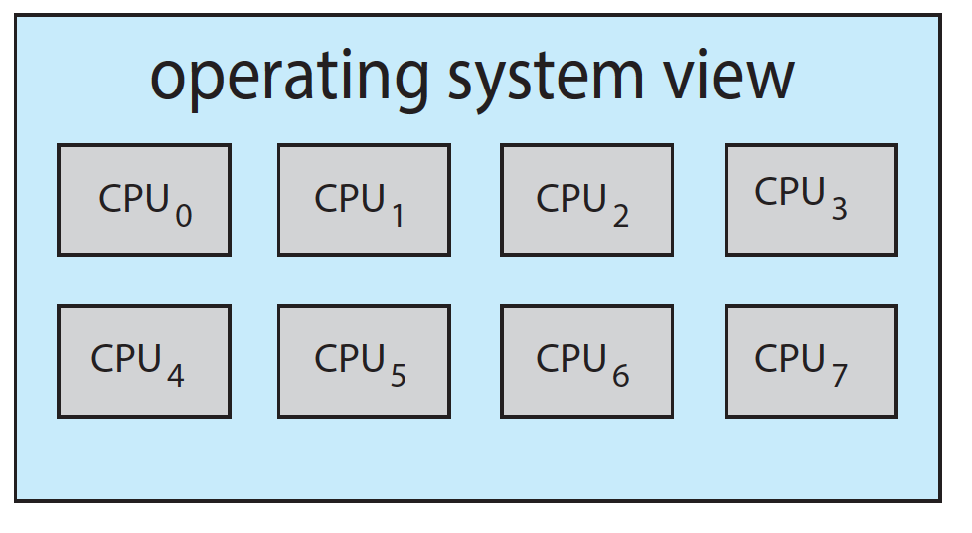
Logical CPUs

Slide 10
Multiple-Processor Scheduling
CPU scheduling more complex when multiple CPUs are available
Asymmetric multiprocessing – only one processor accesses the system data structures, alleviating the need for data sharing
Symmetric multiprocessing (SMP) – each processor is self-scheduling, all processes in common ready queue, or each has its own private queue of ready processes
Currently, most common

Slide 11
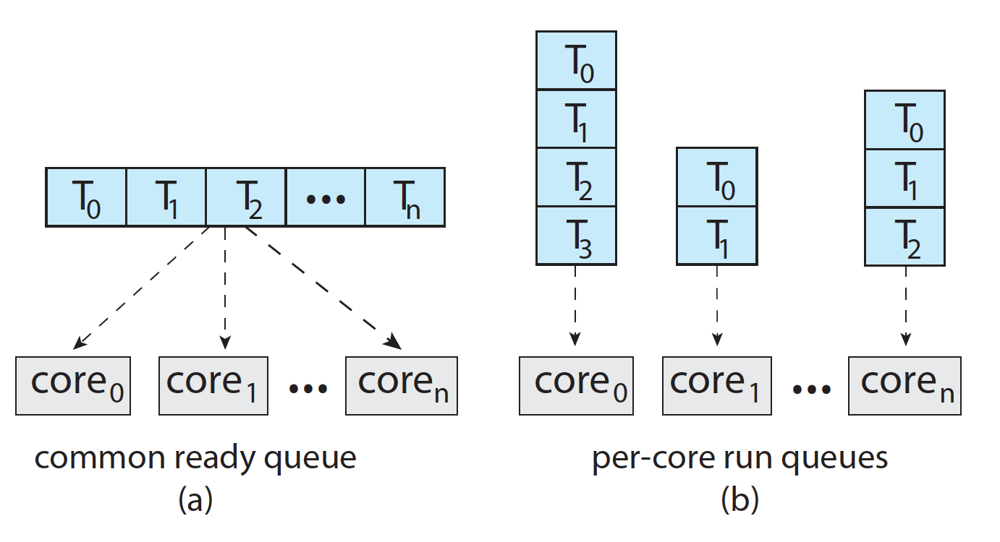
Ready Queue for Multiprocessor

Slide 12
Processor Affinity
Processor affinity – process has affinity for processor on which it is currently running
soft affinity
hard affinity

Slide 13
Hard Affinity
Bound thread to CPU
API
sched_setaffinity()
Question
Notes:
top 按 1: 查看所有核
top 按 H: 查看线程
top -p PID: 查看某一特定进程（top -p pid1 -p pid2）
top: 按f设置显示列，按空格选定P查看运行核，q退出
更多方法见：https://blog.csdn.net/ibless/article/details/82431101
cat /proc/cpuinfo
lscpu
一定 sudo 执行：sched_setaffinity( )

Slide 14
Load Balancing
If SMP, need to keep all CPUs loaded for efficiency
Load balancing attempts to keep workload evenly distributed
Push migration – periodic task checks load on each processor, and if found pushes task from overloaded CPU to other CPUs
Passive
Pull migration – idle processors pulls waiting task from busy processor
Active (idle process)
Counteracts the benefits of processor affinity

Slide 15
Non-uniform Memory Access

Slide 16
NUMA and CPU Scheduling
Note that memory-placement algorithms can also consider affinity
Notes:
Memory affinity

Slide 17
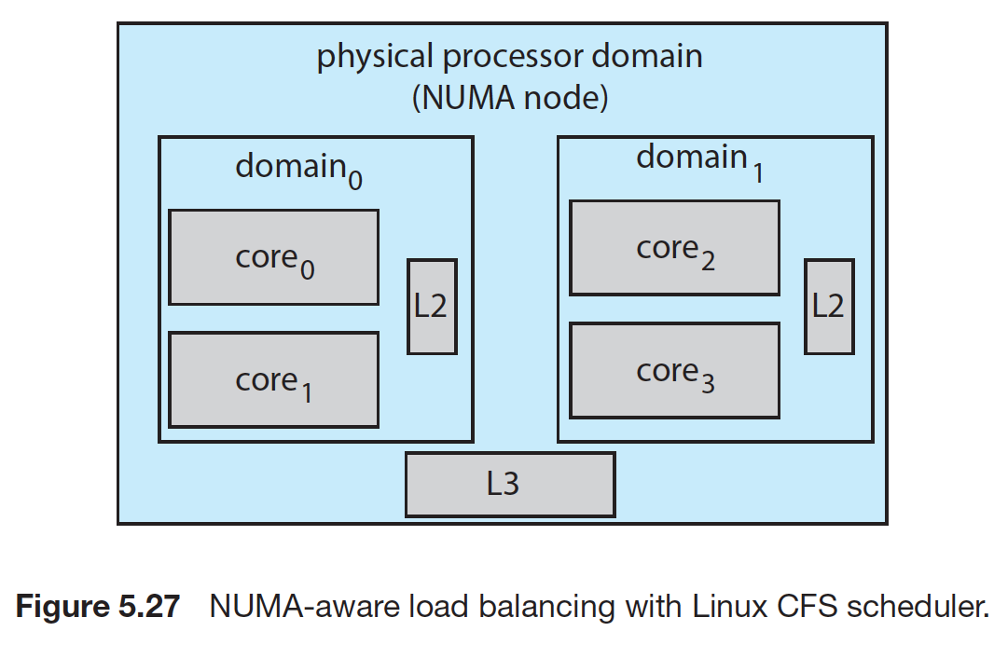
Linux Load Balancing

Slide 18
Heterogeneous Multiprocessing

Slide 19
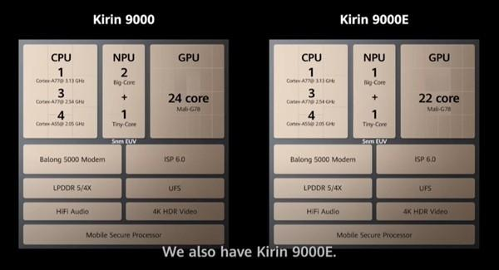

Kirin 9000
Notes:
2020.3.26发布p40

Slide 20
HMP
big.LITTLE where higher-performance big cores are combined with energy efficient LITTLE cores
a CPU scheduler can assign tasks that do not require high performance, but may need to run for longer periods, (such as background tasks) to little cores
Additionally, if the mobile device is in a power-saving mode, energy-intensive big cores can be disabled and the system can rely solely on energy-efficient little

Slide 21
Thread Scheduling

Slide 22
Thread Scheduling
Distinction between user-level and kernel-level threads
When threads supported, threads scheduled, not processes
Many-to-one and many-to-many models, thread library schedules user-level threads to run on LWP
Known as process-contention scope (PCS) since scheduling competition is within the process
Typically done via priority set by programmer
Kernel thread scheduled onto available CPU is system-contention scope (SCS) – competition among all threads in system

Slide 23
Thread Scheduling
Notes:
Give an example!

Slide 24
The End of Chapter 5

Slide 25
Chapter 6: Process Synchro
Background
The Critical-Section Problem
Software Solution
Synchronization Hardware
Mutex Locks
Semaphore

Slide 26
Objectives
To introduce the critical-section problem, whose solutions can be used to ensure the consistency of shared data
To present both software and hardware solutions of the critical-section problem
To explore several tools that are used to solve process synchronization problems

Slide 27
Background
Processes can execute concurrently
May be interrupted at any time, partially completing execution
Concurrent access to shared data may result in data inconsistency
Maintaining data consistency requires mechanisms to ensure the orderly execution of cooperating processes

Slide 28
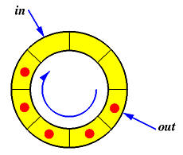
Producer
while (true) { /* produce an item in next produced */
while (counter == BUFFER_SIZE) ;
/* do nothing */
buffer[in] = next produced;
in = (in + 1) % BUFFER SIZE;
counter++;
}

Slide 29
Consumer
while (true) {
while (counter == 0)
; /* do nothing */
next consumed = buffer[out];
out = (out + 1) % BUFFER_SIZE;
counter--;
/* consume the item in next consumed */
}

Slide 30
Result
counter++ could be implemented as register1 = counter register1 = register1 + 1 counter = register1
counter-- could be implemented as register2 = counter register2 = register2 - 1 counter = register2
Consider this execution interleaving with “count = 5” initially:
S0: producer execute register1 = counter {register1 = 5} S1: producer execute register1 = register1 + 1 {register1 = 6} S2: consumer execute register2 = counter {register2 = 5} S3: consumer execute register2 = register2 – 1 {register2 = 4} S4: producer execute counter = register1 {counter = 6 } S5: consumer execute counter = register2 {counter = 4}
Demo
Notes:
Given an example: objdump -d [filename]

Slide 31
Race condition
several processes access and manipulate the same data concurrently and the
outcome of the execution depends on the particular order in which the access takes place

Slide 32
Critical Section Problem
Consider system of n processes {p₀, p₁, … p_{n-1}}
Each process has critical section segment of code
Process may be changing common variables, updating table, writing file, etc
When one process in critical section, no other may be in its critical section
That is, no two processes are executing in their critical sections at the same time
Critical section problem is to design protocol to solve this

Slide 33
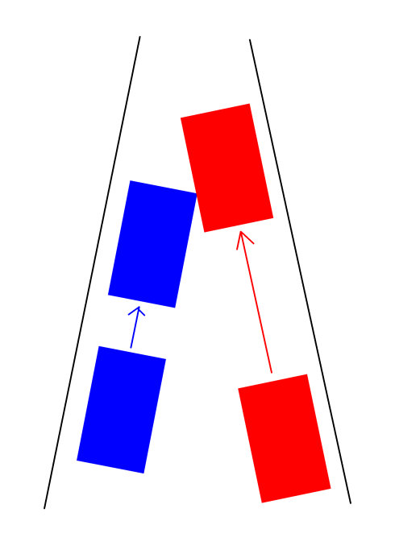
Critical Section Problem

Slide 34
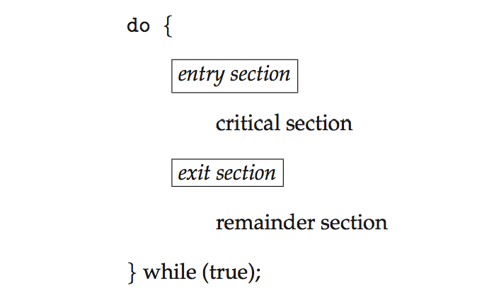
Critical Section
Each process must ask permission to enter critical section in entry section, may follow critical section with exit section, then remainder section

Slide 35
Solution Requirements for Critical-Section Problem
Mutual Exclusion - If process P_{i} is executing in its critical section, then no other processes can be executing in their critical section
Progress - If no process is executing in its critical section and there exist some processes that wish to enter their critical section, then only those processes that are not executing in their remainder sections can participate in deciding which will enter its critical section next, and this selection cannot be postponed indefinitely
3. Bounded Waiting - A bound must exist on the number of times that other processes are allowed to enter their critical sections after a process has made a request to enter its critical section and before that request is granted

Slide 36
Solution 1
flag = false;
//P0
while (flag == true); //do nothing
flag = true;
//critical section;
flag = false;
//remainder section;
//P1
while (flag == true); //do nothing
flag = true;
//critical section;
flag = false;
//remainder section;
What’s the problem?
Notes:
Mutual exclusion violated

Slide 37
Solution 2
turn = 0;
//P0
while (turn == 1); //do nothing
//critical section;
turn = 1;
//remainder section;
//P1
while (turn == 0); //do nothing
//critical section;
turn = 0;
//remainder section;
remainder
What’s the problem?
Notes:
Take turns
Can have mutual exclusion but may not make progress

Slide 38
Solution 3
//P0
flag[0] = true;
while (flag[1] == true); //do nothing
//critical section;
flag[0] = false;
//remainder section;
//P1
flag[1] = true;
while (flag[0] == true); //do nothing
//critical section;
flag[1] = false;
//remainder section;
What’s the problem?
Notes:
Have mutual exclusion but may not make progress (deadlock)

Slide 39
Peterson’s Solution
Good algorithmic description of solving the problem
Two process solution
The two processes share two variables:
int turn;
Boolean flag[2]
The variable turn indicates whose turn it is to enter the critical section
The flag array is used to indicate if a process is ready to enter the critical section. flag[i] = true implies that process P_{i} is ready!

Slide 40
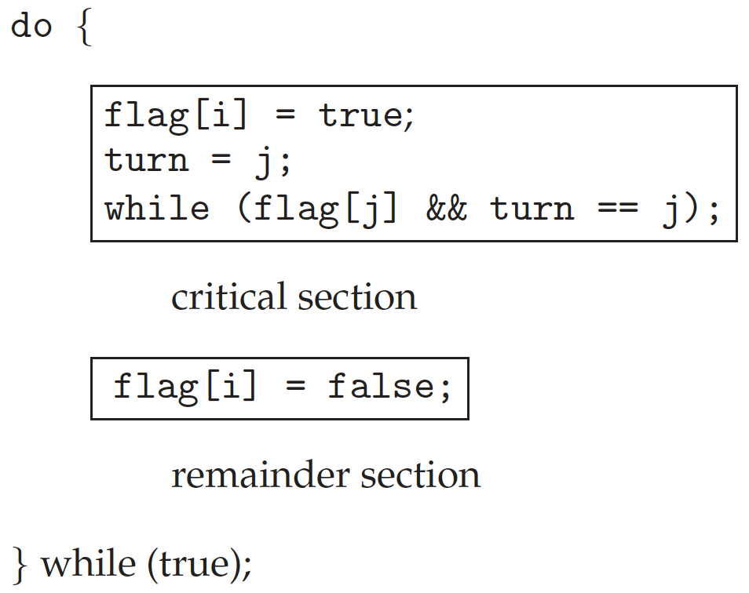
Algorithm for Process P_{i}

Slide 41
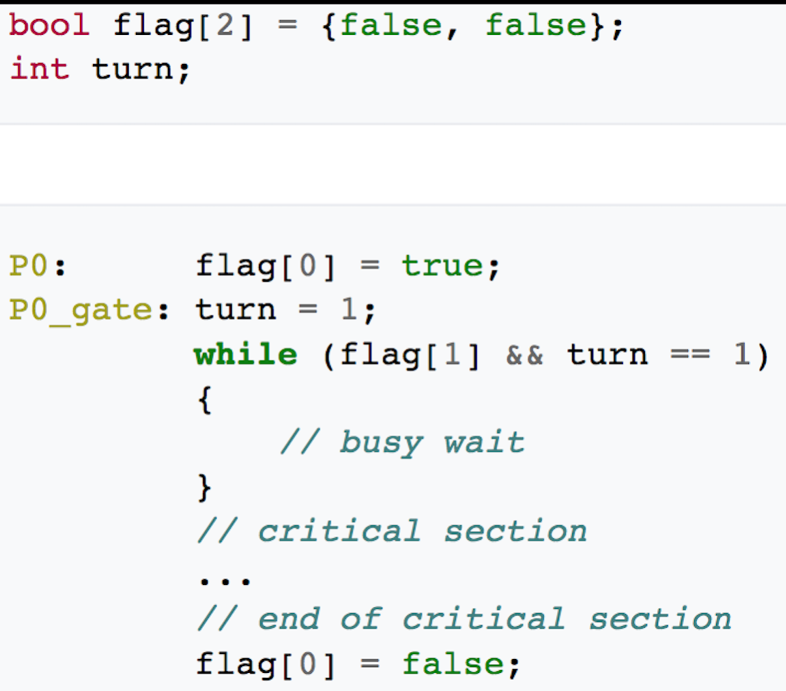
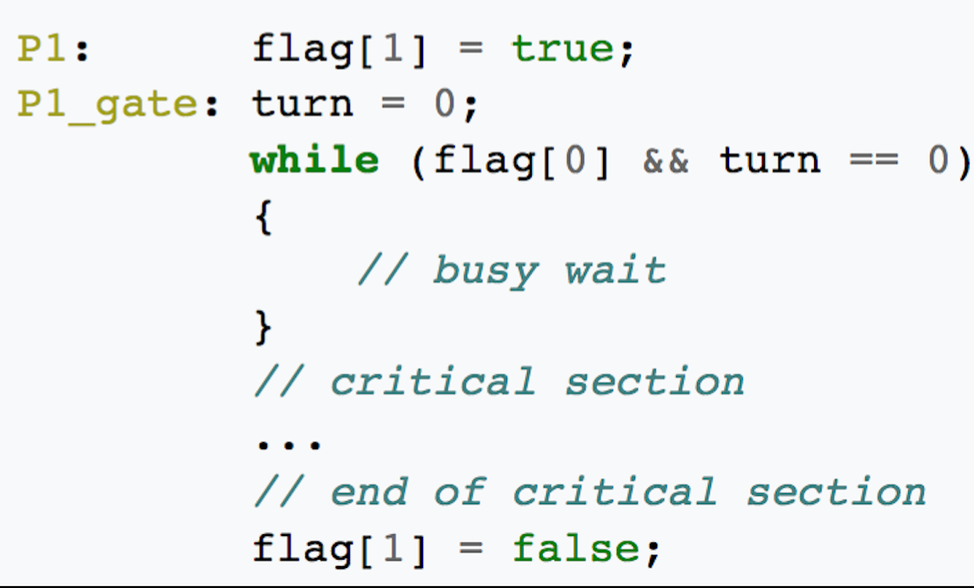
Correctness
Provable that
Mutual exclusion is preserved
Progress requirement is satisfied
Bounded-waiting requirement is met

Slide 42
Mutual Exclusion
while True:
while True:

Slide 43
Process
while True:
while True:

Slide 44
Bounded Waiting
while True:
while True:

Slide 45
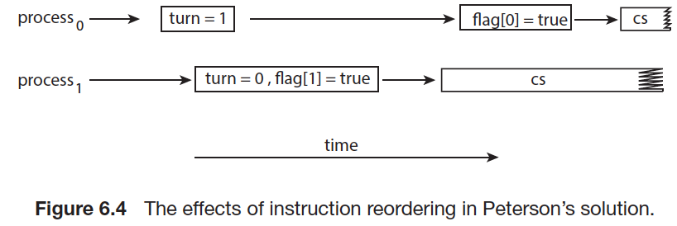
Restrictions of Peterson’s: Reorder
Two process
Software solution

Slide 46
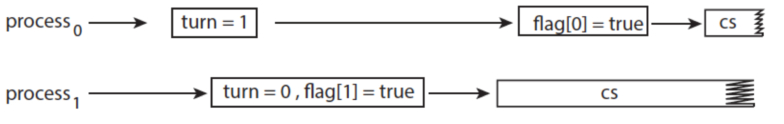
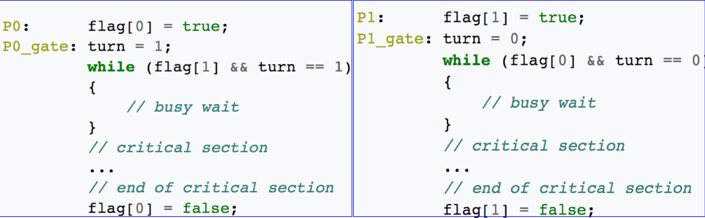
Restrictions of Peterson’s: Reorder
4
1
5
2
6
3

Slide 47
Synchronization Hardware
Many systems provide hardware support for critical section code
All solutions below based on idea of locking
Protecting critical regions via locks
Uniprocessors – could disable interrupts
Currently running code would execute without preemption
Generally too inefficient on multiprocessor systems
Operating systems using this not broadly scalable
Modern machines provide special atomic hardware instructions
Atomic = non-interruptible
Either test memory word and set value
Or swap contents of two memory words
What is atomic?
Notes:
All or none

Slide 48
Solution 1
flag = false;
//P0
while (flag == true); //do nothing
flag = true;
//critical section;
flag = false;
//remainder section;
//P1
while (flag == true); //do nothing
flag = true;
//critical section;
flag = false;
//remainder section;
Notes:
Mutual exclusion violated

Slide 49
test_and_set Instruction
Definition:
boolean test_and_set(boolean *lock)
{
boolean test_lock = *lock;
*lock = true; //set
return test_lock; //test
}
boolean lock = false;

Slide 50
Mutex Solution using test_and_set()
Shared Boolean variable lock, initialized to false (unlocked)
Solution:
do
{ while(test_and_set(&lock)); /* do nothing */
/* critical section */
lock = false;
/* remainder section */
} while (true);

Slide 51
compare_and_swap Instruction
Definition:
int compare_and_swap(int *lock, int expected, int new)
{
int curr_lock = *lock;
if (*lock == expected) //expected = 0
*lock = new; //new = 1
return curr_lock;
}
int lock = 0; //unclocked

Slide 52
Mutex Solution using compare_and_swap
Shared integer variable lock initialized to 0; //unlocked
Solution:
do
{ while(compare_and_swap(&lock, 0, 1) != 0); //do nothing
/* critical section */
lock = 0;
/* remainder section */
} while(true);

Slide 53
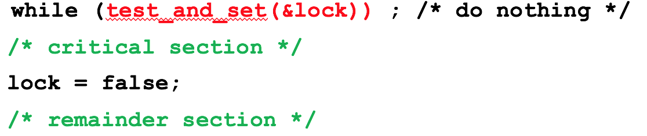
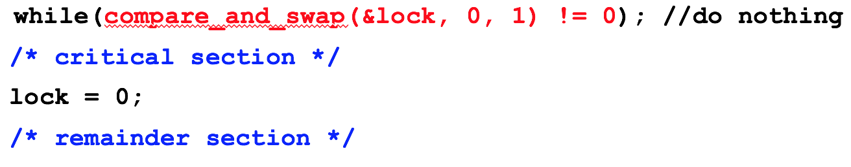
Atomic Instruction Solution

Slide 54
Mutex Locks
Previous solutions are complicated and generally inaccessible to application programmers
OS designers build software tools to solve critical section problem
Simplest is mutex lock
Product critical regions with it by first acquire() a lock then release() it
Boolean variable indicating if lock is available or not

Slide 55
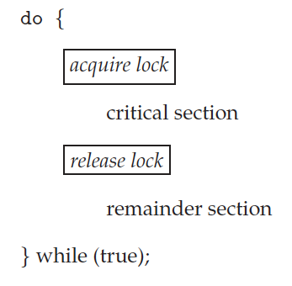

Solution to Critical-section Problem Using Locks
test_and_set
compare_and_swap
demo

Slide 56
Mutex Locks
Calls to acquire() and release() must be atomic
Usually implemented via hardware atomic instructions
But this solution requires busy waiting
This lock therefore called a spinlock

Slide 57
Limitations of Mutex
Busy waiting
Wait queue

Slide 58
The End

